Slide 1
Employee Data Analysis using Excel
STUDENT NAME: NARAYANI.R
REGISTER NO: 122202047
DEPARTMENT: B.COM (CORPORATE SECRATERYSHIP )
COLLEGE: ANNA ADARSH COLLEGE FOR WOMEN
NM ID: asunm1353122202047

Slide 2
PROJECT TITLE
Using Pivot Tables For Employee Turnover Analysis

Slide 3


AGENDA
Problem Statement
Project Overview
End Users
Our Solution and Proposition
Dataset Description
Modelling Approach
Results and Discussion
Conclusion
3/21/2024 Annual Review

Slide 4

PROBLEM STATEMENT
Analyzing employee performance using Excel involves several steps to collect, organize, and evaluate data effectively. Here's a step-by-step guide to help you with this process:
1. Define Key Performance Indicators (KPIs)
2. Collect Data
3. Set Up Your Excel Spreadsheet
4. Enter Data
5. Calculate Performance Scores
6. Use Pivot table
7. Create Charts
8. Analyze the Data
9. Generate Reports
10. Review and Update Regularly

Slide 5

PROJECT OVERVIEW
Objective:
To develop a comprehensive performance analysis system using Microsoft Excel that allows for the effective evaluation of employee performance based on predefined Key Performance Indicators (KPIs). This system aims to identify top performers, track performance trends, and provide actionable insights to support decision-making and improvement strategies.
Scope:
The project involves creating an Excel-based performance analysis tool that includes data collection, organization, calculation of performance scores, and visualization of results. This tool will support performance management and help in making informed HR decisions.

Slide 6

WHO ARE THE END USERS?
The end users of an employee performance analysis system using Excel typically include various stakeholders within an organization. Each user group interacts with the system in different ways and for different purposes:
HR Managers
Department Heads/Managers
Executives/Senior Leadership
Employees
Performance Analysts
Training and Development Teams
Recruitment Teams

Slide 7

OUR SOLUTION AND ITS VALUE PROPOSITION
The Performance Management Dashboard is a comprehensive Excel-based tool designed to analyze, visualize, and manage employee performance data efficiently. It provides a centralized platform where HR managers, department heads, executives, and other stakeholders can access, analyze, and act on performance data in a structured and insightful manner.
Enhanced Decision-Making
Increased Efficiency
Improved Performance Management
Actionable Insights
Scalability and Customization
Cost-Effective Solution
User Empowerment

Slide 8
Dataset Description
The dataset for the Performance Management Dashboard is designed to capture and analyze key aspects of employee performance. It consists of multiple data fields that provide a comprehensive view of each employee's performance metrics. Here’s a detailed description of the dataset structure and the significance of each data field:
Employee ID
Name
Gender
Department
Salary
Start date
FTE
Employee type
Work location

Slide 9

THE "WOW" IN OUR SOLUTION
The dataset for the Performance Management Dashboard is designed to capture and analyze key aspects of employee performance. It consists of multiple data fields that provide a comprehensive view of each employee's performance metrics. Here’s a detailed description of the dataset structure and the significance of each data field:
Dynamic Data Summarization
Interactive Data Exploration
Customizable Views and Reports
Trend Analysis and Comparison
Visual Data Representation
Efficient Data Management
Advanced Filtering and Grouping
3/21/2024 Annual Review
9

Slide 10
MODELLING
To visualize employee performance data using a bar chart in Excel, follow these steps after setting up your data and creating a PivotTable:
Create a pivot table(if not already done)
Set up the pivot table
Insert a bar chart
Customize the bar chart
Update and refresh
Save and share
10

Slide 11
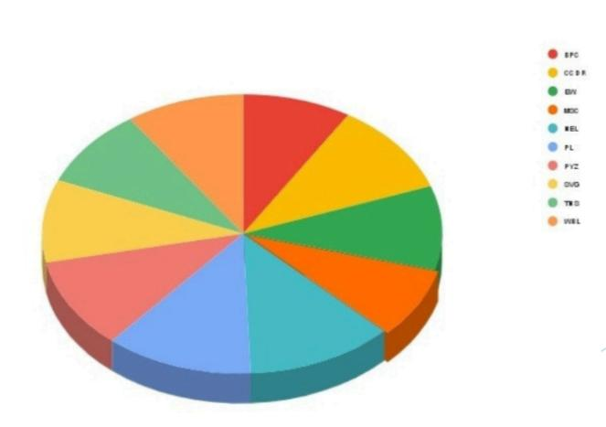
RESULTS
11

Slide 12
conclusion
Utilizing Excel for analyzing employee performance through PivotTables and bar charts provides a robust method for gaining insights into data. PivotTables enable dynamic data summarization, allowing you to organize and filter performance metrics by different dimensions such as employee names, departments, or roles. This facilitates detailed analysis and helps in identifying trends and patterns.
Bar charts, on the other hand, offer a clear visual representation of performance metrics, making it easy to compare individual or departmental achievements at a glance. They highlight disparities and trends in performance, aiding in quick decision-making and strategic planning.Together, these tools enhance your ability to monitor, evaluate, and act on employee performance data effectively, leading to more informed management decisions and better overall performance management.

